Slide 1

House Price Prediction
by
H. Javeed
Roll No. 184G1A0526
P. Bhavya sri
Roll No. 184G1A0508
A. Prathibha
Roll No. 184G1A0559
A. Harshitha
Roll No. 184G1A0522
Under the guidance of
Dr. B. Hari Chandana M.Tech., Ph.D
Assistant Professor
Department of Computer Science and Engineering
Srinivasa Ramanujan Institute of Technology
(Affiliated to JNTUA & Approved by AICTE) (Accredited by NAAC with ‘A’ Grade & Accredited by NBA (EEE, ECE & CSE)
Rotarypuram Village, B K Samudram Mandal, Ananthapuramu – 515701.
2021 - 2022

Slide 2
Abstract
Nowadays the real estate market is a standout amongst the most focused regarding pricing and its keep fluctuating. Instead of this it provides better customer services and safer automobile system. This all of things shows that ML is trending technology in almost all fields so we are trying to coined up ML in our project. So, the main aim of our project is to predict accurate price of house without any loss. There are many factors that have to be taken into consideration for predicting house price and try to predict efficient house pricing for customers with respect to their budget as well as according to their priorities.
So, we are creating a house price prediction model. By using Machine learning algorithms like Linear Regression, Decision Tree Regression, XGBOOST and Random Forest Regression. This model will help people to put resources into a bequest without moving towards a broker. The result of this research provide that the XGBoost Regressor gives maximum accuracy.

Slide 3

Contents
Introduction
Literature Survey
Existing System
Proposed System
Problem Definition
Requirements
UML Diagrams
Data Flow Diagrams
Sample code
Screenshots
Conclusion
References

Slide 4
Introduction
In this project, we have built a machine learning model to predict the house prices of a particular state. This project will be very helpful for the real estate market. Our model can be used by both house sellers and house buyers.
Determining a house price is a challenging task, due to which many factors are considered for determining the house price on the market and demand for houses grow rapidly over the years as people’s living standards improved.
House price prediction can help the developer to determine the selling price of a house and can help the customer to arrange the right time to purchase a house.
The focus of project is mainly to develop a machine learning model that can accurately predict the price based on the features.
Features include :
Area_type, Square_Footage
Availability, Balcony
Location, BHK
Bathrooms, Selling Price

Slide 5
Literature Survey
[Ayush Varma, Abhijit Sarma, Sagar Doshi, Rohini Nair - 1] : Real estate is the least transparent industry in our ecosystem. Housing prices keep changing day in and day out and sometimes are hyped rather than being based on valuation. Predicting housing prices with real factors is the main crux of our research project. Here we aim to make our evaluations based on every basic parameter that is considered while determining the price. We use various regression techniques in this pathway, and our results are not sole determination of one technique rather it is the weighted mean of various techniques to give most accurate results. The results proved that this approach yields minimum error and maximum accuracy than individual algorithms applied. We also propose to use real-time neighborhood details using Google maps to get exact real-world valuations.

Slide 6
…contd
[G. Naga Satish, Ch. V. Raghavendran, M.D.Sugnana Rao, Ch.Srinivasulu -2]: Predictive models for deciding the sale price of houses in metropolitan cities is still remaining as more challenging and trickier task. The sale price of properties in cities like Hyderabad depends on a variety of interdependent factors. Key factors which may affect the house price include area of the property, location of the property and its amenities. In this system, an attempt has been made to construct a predictive model for evaluating the price based on the factors that affect the price. Modelling study apply some supervised learning techniques such as Bayesian classifier or KNN algorithms. Such models are used to build a predictive model, and to pick the best performing model by performing a comparative analysis on the predictive errors obtained between these models. Here, the attempt is to construct a predictive model for evaluating the price based on factors that affects the price. We build this concept as real time application useful for real estate business and also buyer and sellers.

Slide 7
…contd
[CH. Raga Madhuri, G. Anuradha, M. Vani Pujitha - 3]: This paper provides an overview about how to predict house costs utilizing different regression methods with the assistance of python libraries. The proposed technique considered the more refined aspects used for the calculation of house price and provide the more accurate prediction. It also provides a brief about various graphical and numerical techniques which will be required to predict the price of a house. This paper contains what and how the house pricing model works with the help of machine learning and which dataset is used in our proposed model.

Slide 8
Existing System
Buying a house is a stressful thing. One has to pay huge sums of money and invest many hours and even there is a persisting concern whether it’s a good deal or not. Buyers are generally not aware of factors that influence the house prices.
Almost all the houses are described by the total area in square foot, the neighborhoods and the number of bedrooms. Sometimes houses are even priced at X rupees per square foot. This creates an illusion that house prices are dependent almost solely on the above factors. Most of the houses are bought though real estate agents. People rarely buy directly from the seller, since there are a lot of legal terminology and paperwork’s involved and people are unaware of them.
Hence real estate agents are trusted with the communication between buyers and sellers as well as laying down a legal contact for the transfer. This just creates a middle man and increase the cost of the house. Therefore the houses are overpriced and buyer should have a better idea of the actual value of the houses.

Slide 9
Proposed System
This project covers the measures that have been taken by the use of technology that is accessible and utilize them to create an unbiased system for predicting the house price.
We have utilized the gathered data from trusted resources and trained and designed a Machine Learning model in such a way that it provides the best possible predictions of house prices as an output to the user.
Thus, this method in which the complete prediction is based upon the gathered data, the integrity and trustfulness of the system to the user is maintained.
Here we are using Linear Regression, XGBoost, Decision Tree Regression and Random Forest Regression Techniques for predicting the model accurately.

Slide 10
Problem Definition
Prices of real estate properties are sophisticatedly linked with our economy.
Despite this, we do not have accurate measures of house prices based on the vast amount of data available.
Proper and justified prices of properties can bring in a lot of transparency and trust back to the real estate industry, which is very important for most consumers especially in India.

Slide 11
Requirements
Hardware Requirements :
Processor : i3/Intel Processor
RAM : 8GB
Hard Disk : 128GB
Software Requirements :
Operating System : Windows 10
Language : Python 3.8
Platform : Google Collab, Jupyter Notebook
Libraries : Numpy, Pandas, Matplotlib, Seaborn, Sk Learn

Slide 12
UML Diagrams
Activity Diagram: Dataset
YES
NO
LOW
HIGH
Data Preprocessing
If contains Uncleaned data
Perform The Data Splitting into Training and Testing
Training the model
Applying the ML Algorithms
Testing the Accuracy
Trained Model

Slide 13
Data Flow Diagrams
Data Acquisition
Data Preprocessing
ML Model Training
ML Model Evaluation
Deployment
Hyper Parameter Tuning
Feature Engineering

Slide 14
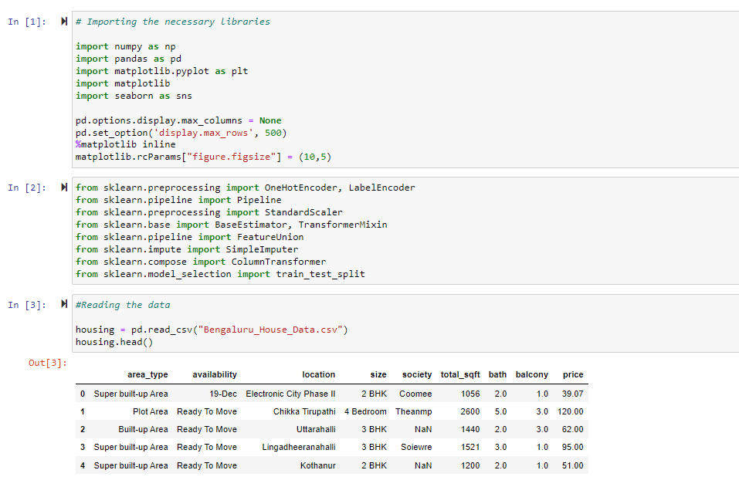
Sample code
Importing the libraries:

Slide 15
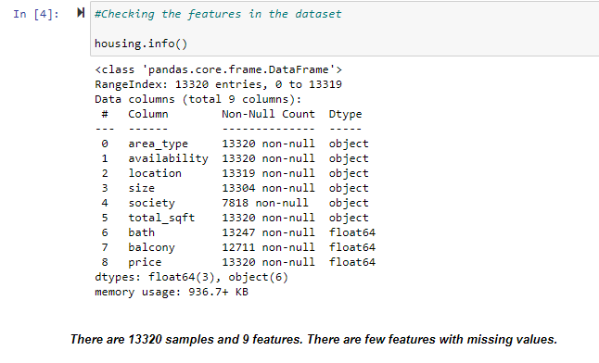
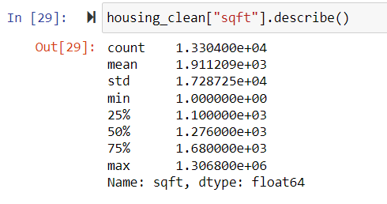
Contd…
Data Visualization:
Checking features in the dataset:
Checking the descriptive stats of the numeric values in the data like mean, standard deviation, min values and max values present in the data

Slide 16
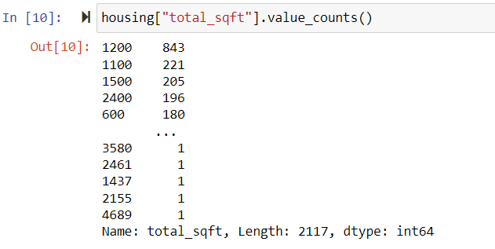
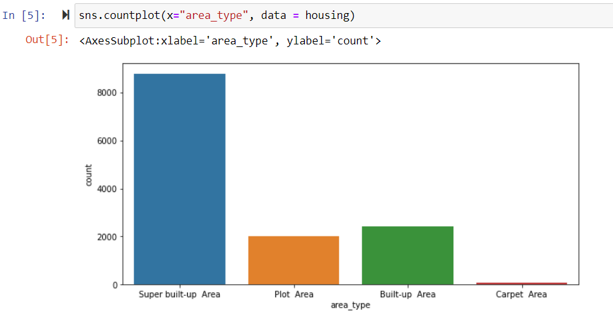
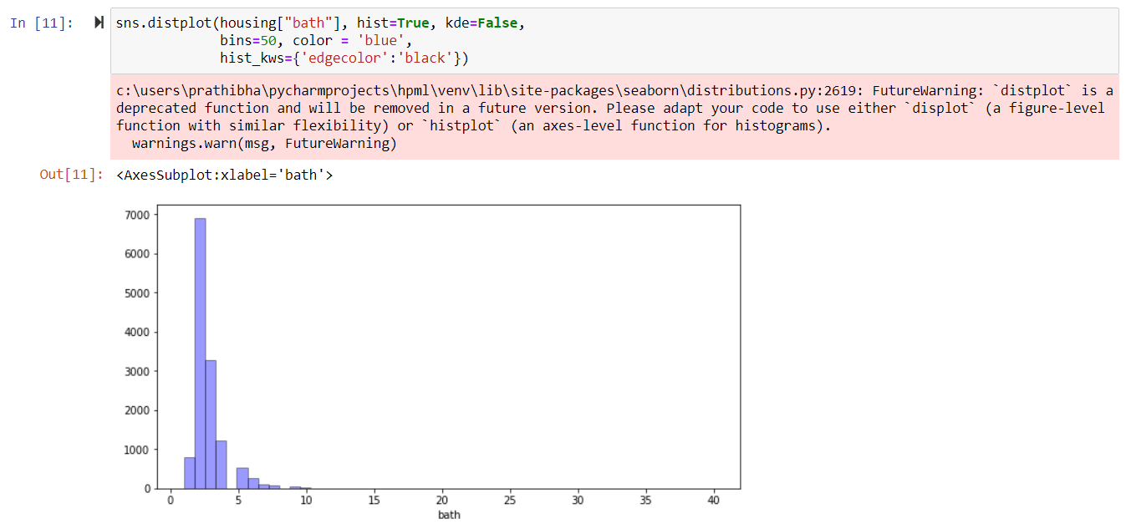
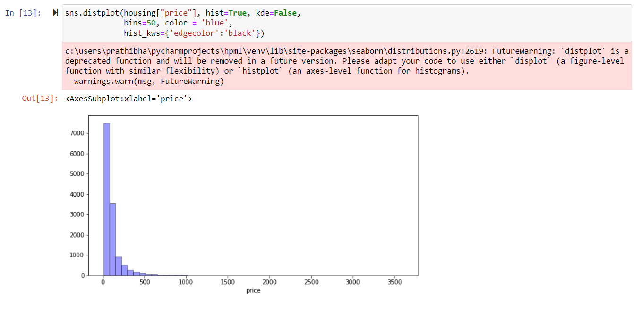
Contd…
Univariate Analysis:

Slide 17
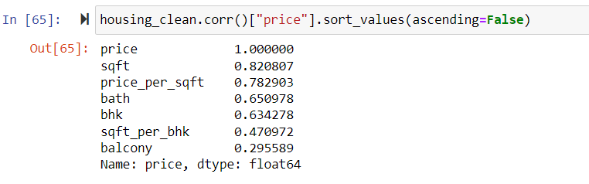
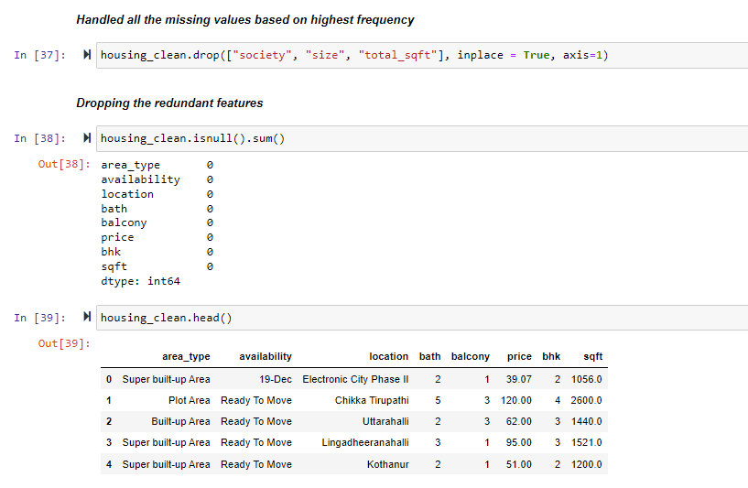
Contd…
Corelation matrix:
Filling Missing values and Label encoding:

Slide 18
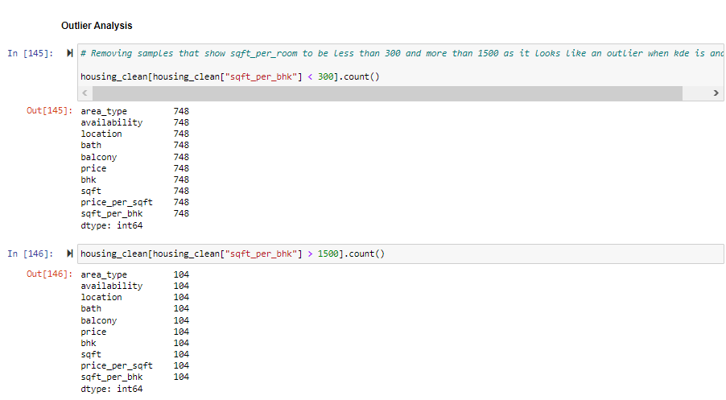
Contd…
Outlier Analysis:

Slide 19
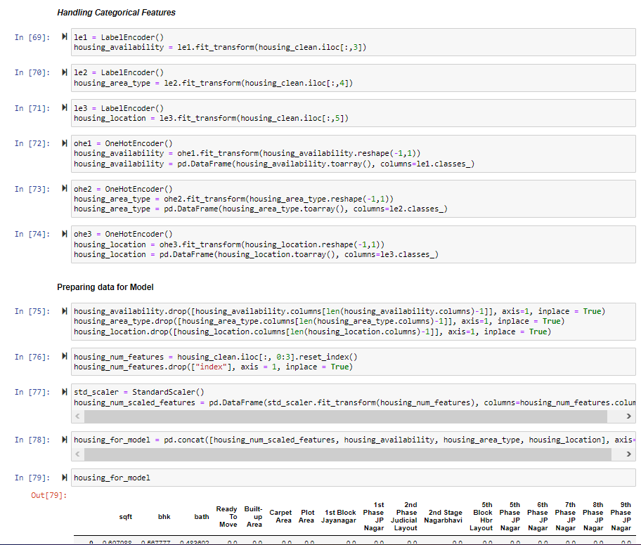
Contd…

Slide 20
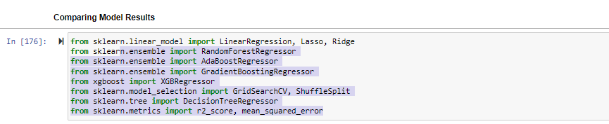
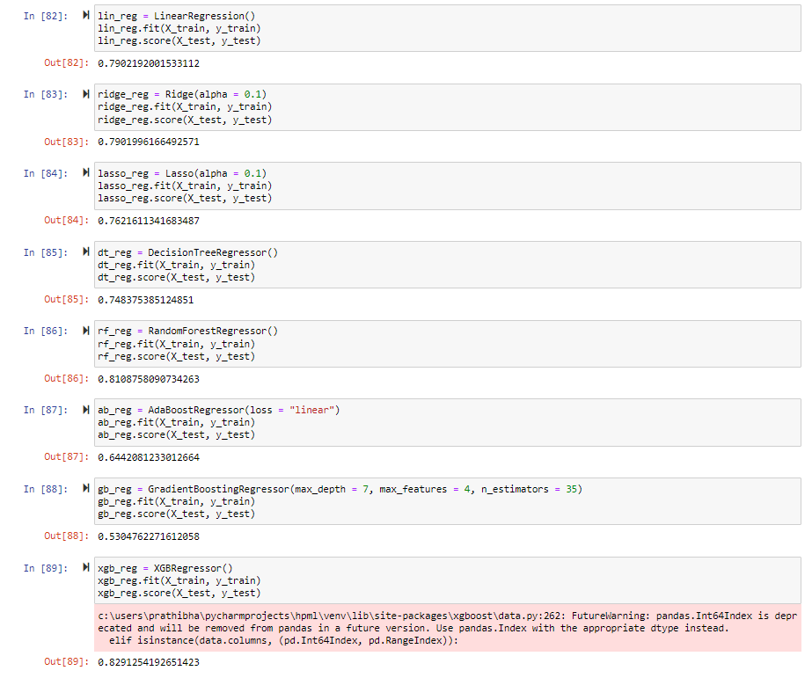
Contd…

Slide 21
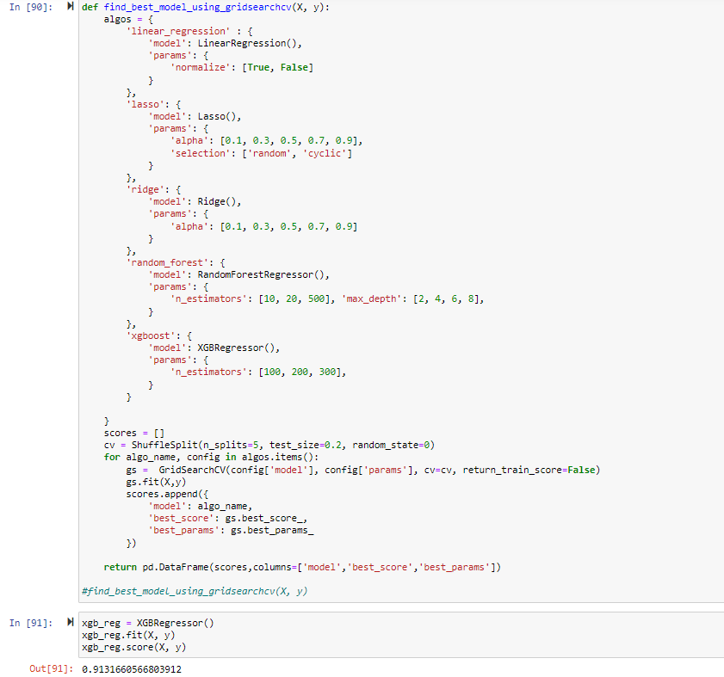
Contd…
Here, we performed the comparison of the models with various machine learning algorithms to predict the maximum accuracy of the model.

Slide 22
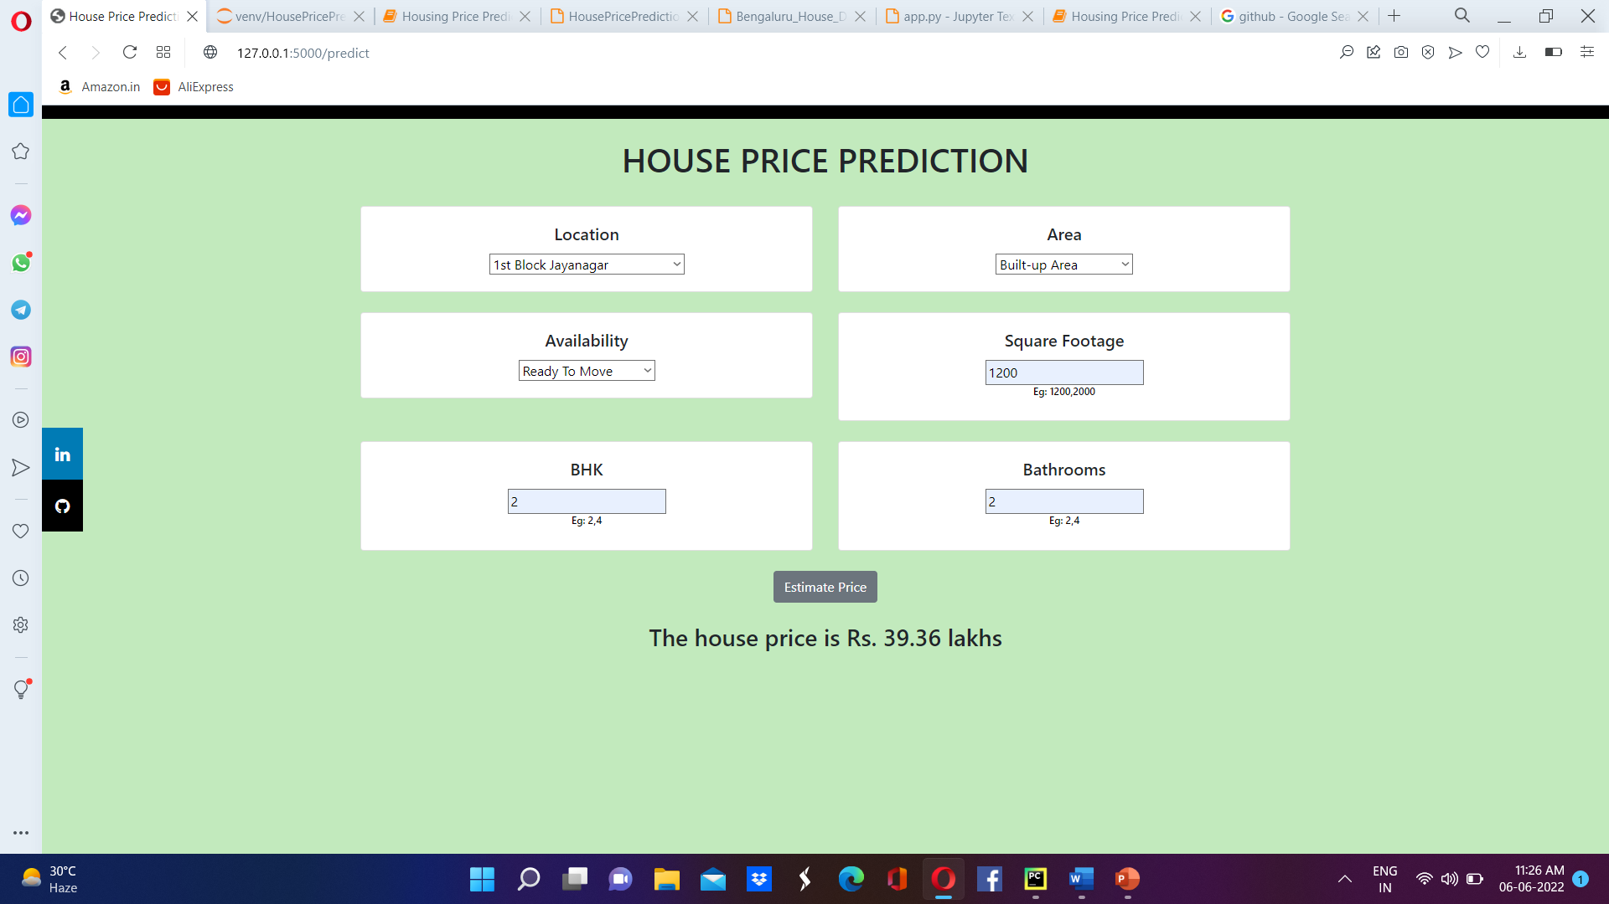
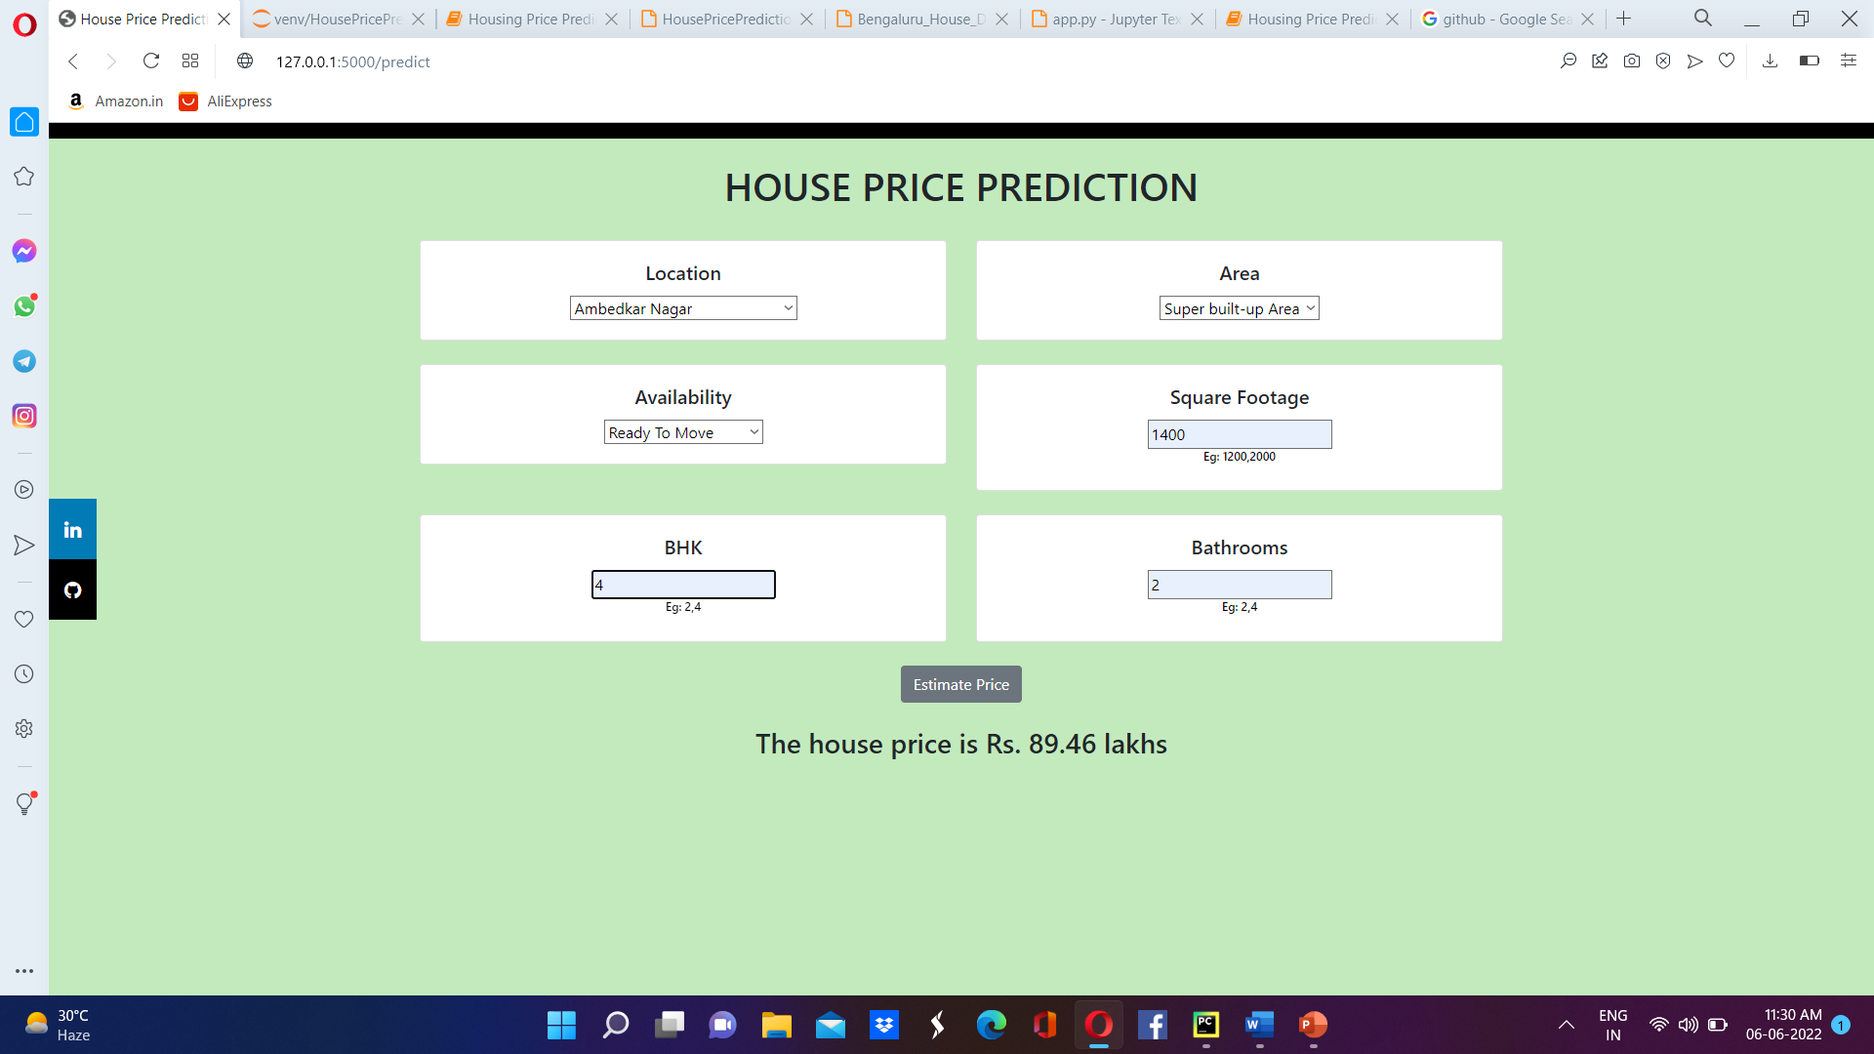
Screenshots

Slide 23
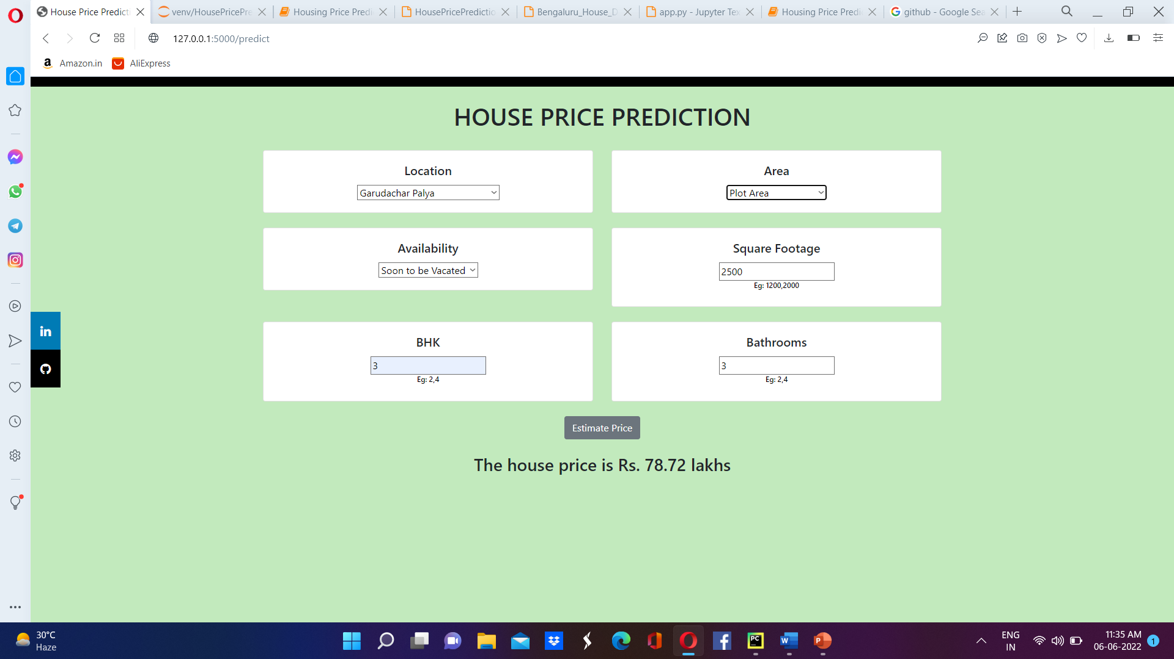

Contd…

Slide 24
Conclusion
By performing the analysis using the following algorithms, XGBoost Regressor provided the high accuracy for the trained model and predicts the House Prices more accurately compared to the other algorithms. XGBoost Regressor provided the accuracy of the model with 91%. By this we can conclude that the prediction of House Prices is made using Regression algorithms and among them XGBoost Regression can predict more accurately compared to the other algorithms.

Slide 25
References
[1]. Ayush Varma, Abhijit Sarma, Sagar Doshi, Rohini Nair, “Housing Price Prediction using
Machine Learning and Neural Networks” 2018, IEEE.
[2]. G. Naga Satish, Ch. V. Raghavendran, M.D.Sugnana Rao, Ch.Srinivasulu, “House Price Prediction Using Machine Learning”, International Journal of Innovative Technology and Exploring Engineering (IJITEE), ISSN: 2278-3075, Vol.8, Issue-9, July 2019.
[3]. CH. Raga Madhuri, G. Anuradha, M. Vani Pujitha, “House Price Prediction Using Regression Techniques: A Comparative Study” in ICSSS, IEEE.
Git hub Repository: https://github.com/prathibha0405/House-Price-Prediction
Referral Link:
..\Downloads\Project Folder\Bengaluru_House_Data.csv

Slide 26
Thank You!!!

